Slide 1

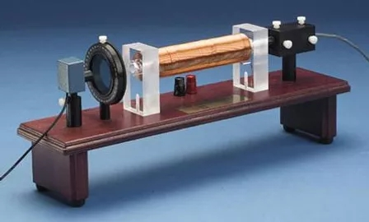
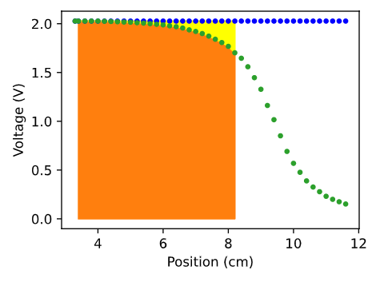
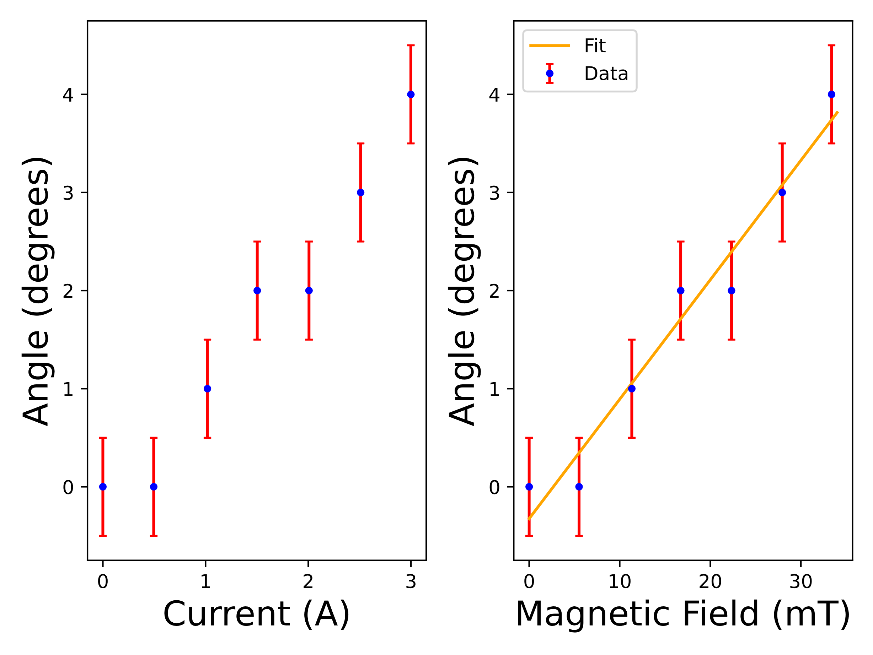
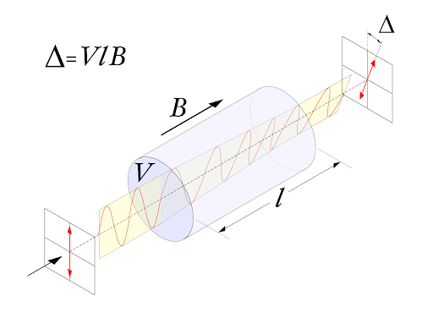
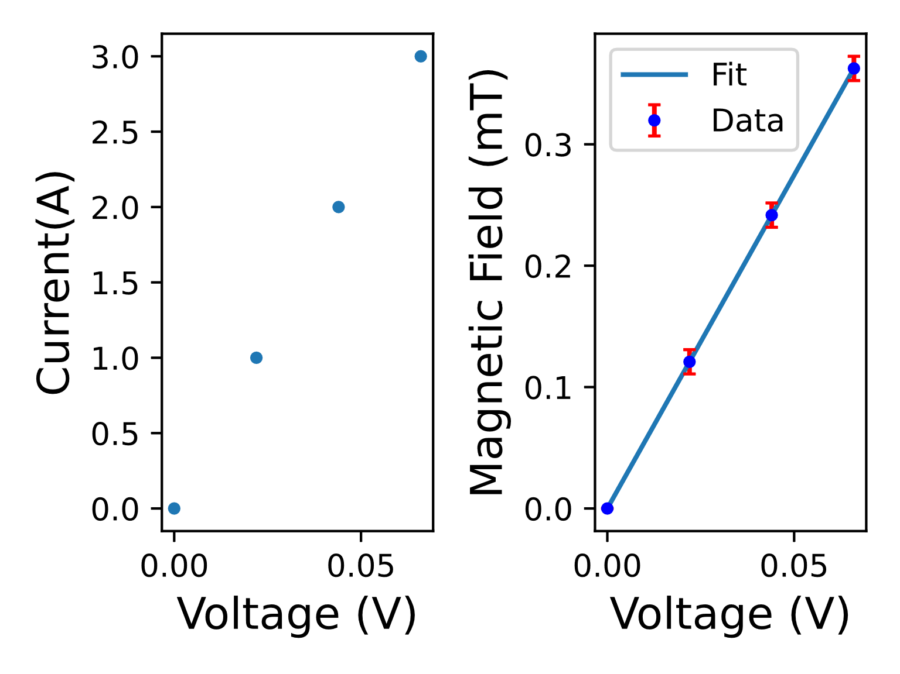




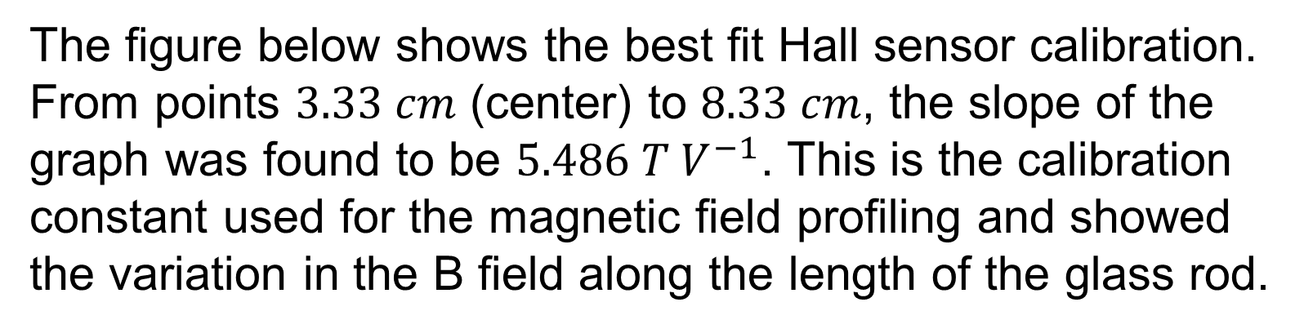

Finding the Verdet Constant for 650 nanometer Light Through SF-59 Glass
John-Paul LaMontagne, Nate Pierce, Dr. Jim Hetrick | Physics Department | University of Michigan - Dearborn
Abstract
Theory
Tttt
In this experiment, material properties of optically transparent material are examined, namely the Verdet constant. The material, SF-59 glass, is placed in a magnetic field generated by a current carrying solenoid surrounding it. Data on the strength of the magnetic field along the length of the sample is collected and used to tabulate the Verdet constant, $\text{υ}=\left(22±2\right) rad T^{−1}m^{−1}$ for partially polarized light from a laser, nominally of λ $= 650 nm$wavelength. This value is accurate relative to the accepted value. Additionally, properties of Malus' Law, Faraday Rotation, and Ampere's Law are verified experimentally.
Faraday rotation is an optical phenomenon produced by circularly polarized light passing through transparent material over which a magnetic field profile exists. Polarized light is represented by a plane wave, which is a superposition of left and right polarized light. The phase speed of these components of the electric field are different for a given medium – a phenomenon called circular birefringence.
$${\vec{E} }_{linear}={\vec{E}}_{right}+{\vec{E}}_{left}$$
The rotation of the orientation of the plane wave entering the tube and the plane wave incident on the detector is given:
$$θ=\text{υ}B_{o}L$$
Since $∆n≠0$ and since $B_{o}∝∆n$, the angle can be rewritten:
$$θ=\frac{ω}{2c}\left(n_{left}−n_{right}\right)L$$
The rotation angle can also be found via Ampere’s Law. The strength of the magnetic field is proportional to current.
$$θ=\text{υ}B_{o}L\frac{\int_{−L/2}^{L/2}{B\left(z\right)dz}}{B_{o}L}$$
The ratio in the above equation is constant. A single tabulation of this quantity is necessary. Call the ratio $f$.
$$θ=\text{υ}B_{o}Lf$$
Plotting of $θ vs. β$ yields a line with slope which can be used to find the Verdet constant:
$$\text{υ}\text{=}\frac{m}{fL}$$
Introduction
Figure 2 – The apparatus used in the TeachSpin experiment. The glass sample is inside of the solenoid. [2]
Figure 4
The first step was to design and build a magnetic field sensing circuit. This was achieved with a Hall sensor and instrumentation amplifier. To calibrate the sensor, several data points were collected over a range of supplied current. From the best fit curve, a calibration constant was generated.
The B-Field permeating the glass sample must be profiled. The calibrated Hall sensor was placed at the center of the solenoid, and the circuit’s output voltage was measured over many data points for half of the length of the sample (starting from the center). Scipy’s Simpson integration method, as well as Pandas dataframes were used in the analysis of the data. The ratio of this area and the maximum area is used in the final calculation of the Verdet constant.
Finally, the data on the rotation angle as a function of current is collected by measuring the output voltage on the photodiode for various magnetic field strengths. From the slope of this plot, the Verdet constant can be calculated.
The figure above shows the variation of the $B$ field along the glass as the green dotted line. The blue dotted line shows the maximum voltage ($2.207 V$). At $3.33 cm$, the Hall probe senses the field at its maximum strength, but near $6 cm$, it starts dropping off. The yellow area signifies the difference between using the Hall probe and the maximum voltage only.
The orange Hall sensor area was calculated to be 96.12% of the total orange + yellow maximum voltage ($B$ field) area. This ratio allowed for a more accurate determination of the Verdet constant.
Faraday rotation refers to shifting of the polarization plane of light as it passes through a transparent material with a magnetic field parallel to its propagation. Although originally discovered by Faraday in 1845, Verdet studied the effect of the magnetic field, wavelength of light, and type of material on the degree of rotation. His discovery shows there is a relationship between light passing through a medium and electromagnetic fields.
The amount of polarization of the light is proportional to three properties of the rod: the magnetic field within, the length, and the Verdet constant.
Methodology
Results & Discussion
The apparatus is composed of five components: a red laser, a glass rod (sample), a solenoid, a Polaroid filter, and a photodiode.
The laser provides 60% polarized light at a nominal wavelength of $650 nm$. It is powered by a $4 V$ power supply. The sample is $10 cm$ in length, $5 cm$ in diameter and made of SF-59 glass. The Slinky solenoid contains $\frac{50 turns}{50 cm}$, with a MCC of $3.0 A$. The Polaroid film is marked in $1°$ increments. The detector photodiode with three selectable resistances ($10, 3, or 1 kΩ$). Care must be taken to avoid saturation of the photodiode ($0.3 V)$ in order to ensure measured signals are within a linear regime.
There are two methods used in finding the Verdet constant. Only one is used in this experiment. This method optimizes sensitivity by measuring the rotation angle $θ$ over an interval of light intensity which has the steepest slope – that is, according to Malus’ Law, the halfway point between peak and trough of the curve generated by:
$$I_{1}=I_{o}\cos^{2}(θ)$$
The figure below shows the best fit Hall sensor calibration. From points $3.33 cm$ (center) to $8.33 cm$, the slope of the graph was found to be $5.486 T V^{−1}$. This is the calibration constant used for the magnetic field profiling and showed the variation in the B field along the length of the glass rod.
Figure 5
The rotation angle vs. magnetic field is shown in the figure above. A slope of $2.125 rad T^{−1}$was determined. The Verdet constant was then solved using this value:
$$\text{υ}=\left(22±2\right) rad T^{−1}m^{−1}$$
The experimental value agrees with the accepted ($23 rad T^{−1}m^{−1}$) value. From this result, we verify theoretical predictions experimentally.
Figure 1 - The Faraday effect along with the Verdet
constant equation. [1]
The Verdet constant can be deduced by knowledge of the magnetic field, length of the material, and angle of polarization.
The goal of this experiment is to accurately measure the Verdet constant of a sample SF-59 glass. Measuring this constant within a certain degree of uncertainty will serve to verify Malus’ Law, the Verdet constant equation, and Faraday rotation as a natural optical phenomenon.
[1] UAF Physics, http://onidan.lasota.org/faraday/faraday_theory.html
[2] “Faraday Rotation.” TeachSpin, www.teachspin.com/faraday-rotation.
References
Special thanks to Dr. Jim Hetrick for his assistance in the collection and analysis of the data.
Acknowledgements
Figure 3

